Slide 1
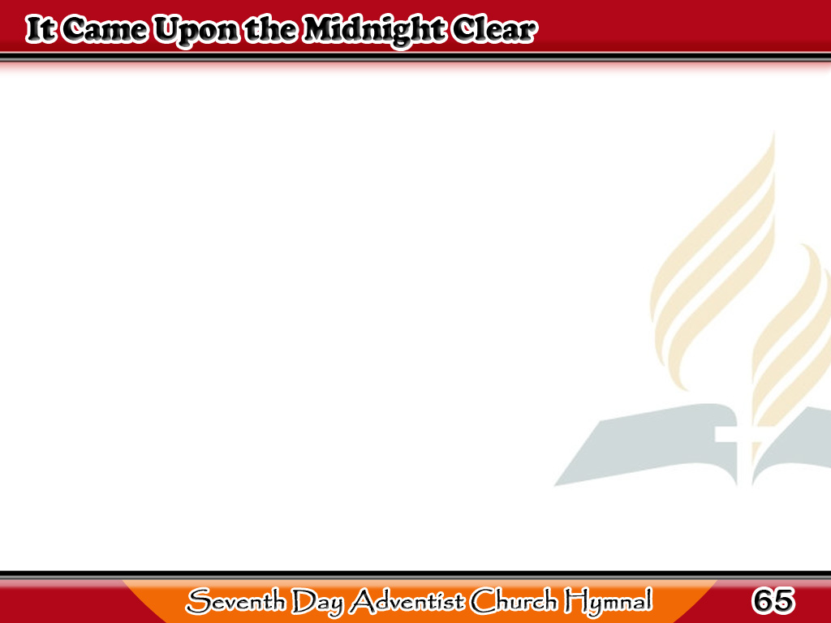
Hatinggabi Nang Marinig
It came upon the midnight clear,
That glorious of old,
From angels bending near
the earth
To touch their harps of gold:
1/3

Slide 2
Hatinggabi Nang Marinig
“Peace on the earth,
good will to men,
From heaven’s all gracious King”
The world in solemn stillness lay,
To hear the angels sing.
1/3

Slide 3
Hatinggabi Nang Marinig
Still through the cloven skies
they come,
With peaceful wings unfurled,
2/3

Slide 4
Hatinggabi Nang Marinig
And still their heavenly
music floats
O’er all the weary world;
2/3

Slide 5
Hatinggabi Nang Marinig
Above its sad lowly plains
They bend on hovering wing,
And ever o’er its Babel sounds
The blessed angels sing.
2/3

Slide 6
Hatinggabi Nang Marinig
And ye, beneath life’s
crushing load,
Whose forms are bending low,
Who toil along the climbing way
With painful steps and slow
3/3

Slide 7
Hatinggabi Nang Marinig
Look now! For glad
and golden hours
Come swiftly on the wing;
O rest beside the weary road,
And hear the angels sing.
3/3

